Slide 1

Managing Data Consistency Among Microservices with Debezium
Justin Chao and Tyler Yam
October 20th, 2020

Slide 2
About Us
Justin Chao
Senior Software Engineer
3rd time attending ATO
linkedin.com/in/justinchao
Tyler Yam
Software Engineer
2nd time attending ATO
linkedin.com/in/tyleryam

Slide 3
Domain Data Ownership

Slide 4
Avoid Dual Writes!

Slide 5
Where does Debezium fit in?
Debezium connectors deployed via Kafka Connect APIs
Captures all data changes
Very low delay
Requires no changes to data model

Slide 6
Debezium Architecture
Disaster Recovery
Eventual Consistency
Offsets
Exactly Once Delivery -> At Least Once Delivery

Slide 7
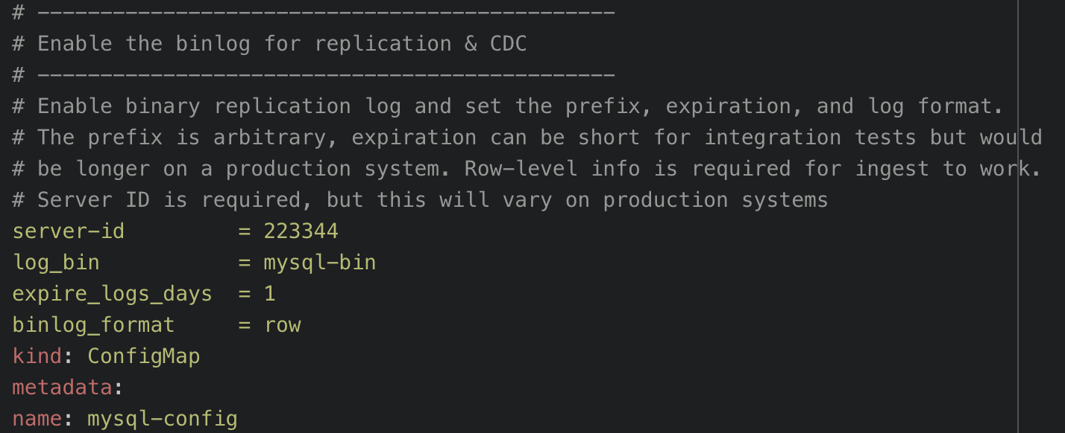
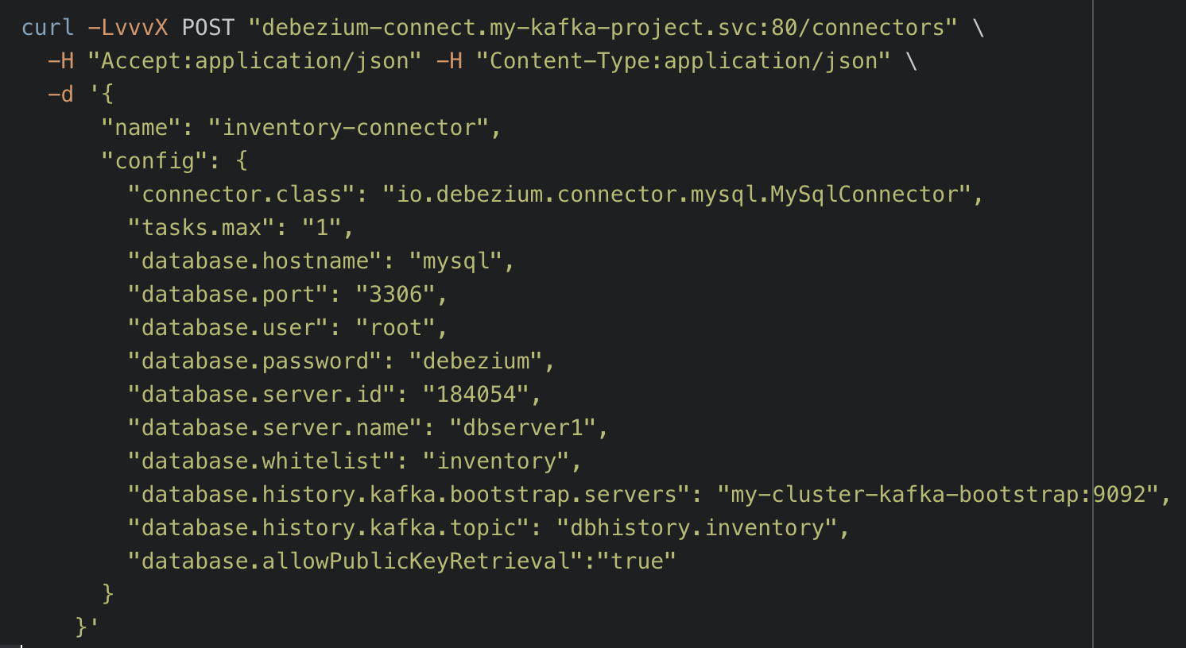
Debezium Requirements
Write Access Log (WAL) configuration
Database RBAC permissions for Debezium

Slide 8
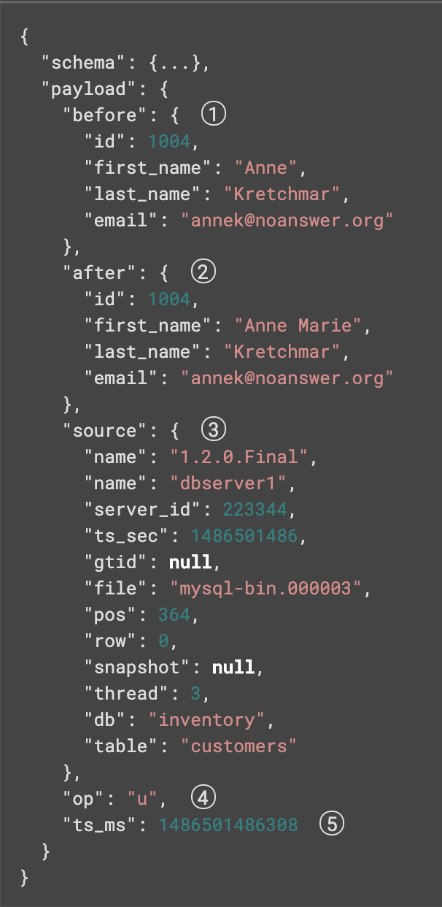
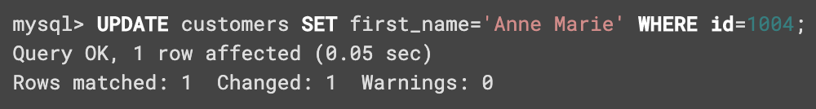
Debezium Change Event - DEMO

Slide 9
Conclusion
Domain Driven Data Ownership
Centralized Streaming Platform with a Distributed Log
Scalable
Retentive & Re-playable
Autonomous services
Change Data Capture with Debezium

Slide 10
Justin Chao and Tyler Yam
Be sure to visit Optum’s virtual booth!!! ☺

